Slide 1
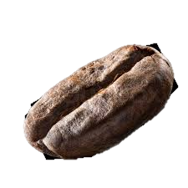


Coffee Quality Dataset Analysis
Name : Karthick.T
Date : 27-06-2025

Slide 2
Project Overview
This project analyzes global coffee data to understand how factors like altitude, variety, and origin affect coffee quality.
It uses data visualization and hypothesis testing to uncover meaningful insights for producers and consumers.

Slide 3
Dataset Description
The dataset originally contained 44 columns and 13,340 rows.
Each row represents a coffee sample evaluated by professional graders.
Key features include:
Farm details – Farm.Name, Owner, Mill, Region, Country.of.Origin
Coffee variety and processing – Variety, Processing.Method
Altitude information – altitude_low_meters, altitude_high_meters, altitude_mean_meters
Grading information – Grading.Date, Harvest.Year, Expiration
Defect scores – Category.One.Defects, Category.Two.Defects,Quakers
Cup quality attributes – Aroma, Flavor, Aftertaste, Acidity, Body, Balance, Uniformity, Sweetness, Clean.Cup, Overall, Total.Cup.Points
Certification info – Certification.Body, Certification.Address, Certification.Contact
Export details – Number.of.Bags, Bag.Weight, Unit.of.mesurements

Slide 4
Dataset Cleaning
Standardized spelling and corrected inconsistencies in categorical columns.
Dropped columns with redundant or irrelevant data:
Certification Body, Address, Contact, Lot Number, ICO Number, Altitude range, Owner.1
Dropped rows where over 50% data was missing and all numerical values were zero.
Color Variety & Processing Method column: Replaced nulls with "Other".
Owner column: Filled based on most frequent (mode) value per country.
Replaced nulls with "Other".
Quakers: Filled with 0 if one defect category was 0.
Other categorical columns: Replaced nulls with "Unknown".

Slide 5
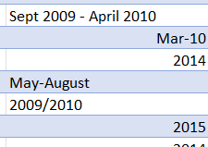
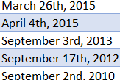
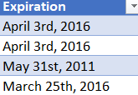
Dataset Cleaning
Other categorical columns: Replaced nulls with "Unknown".
Reformatted Grading Date and Expiration Date using regex, then converted to datetime.
Estimated missing Harvest Year based on the difference between Grading and Expiration dates.
Visualized using boxplots and histograms.
Replaced outliers with median or appropriate statistical methods.
Dropped In Country Partner as it duplicated information in Certification Body.
Dropped Altitude High and Altitude Low due to redundancy.

Slide 6
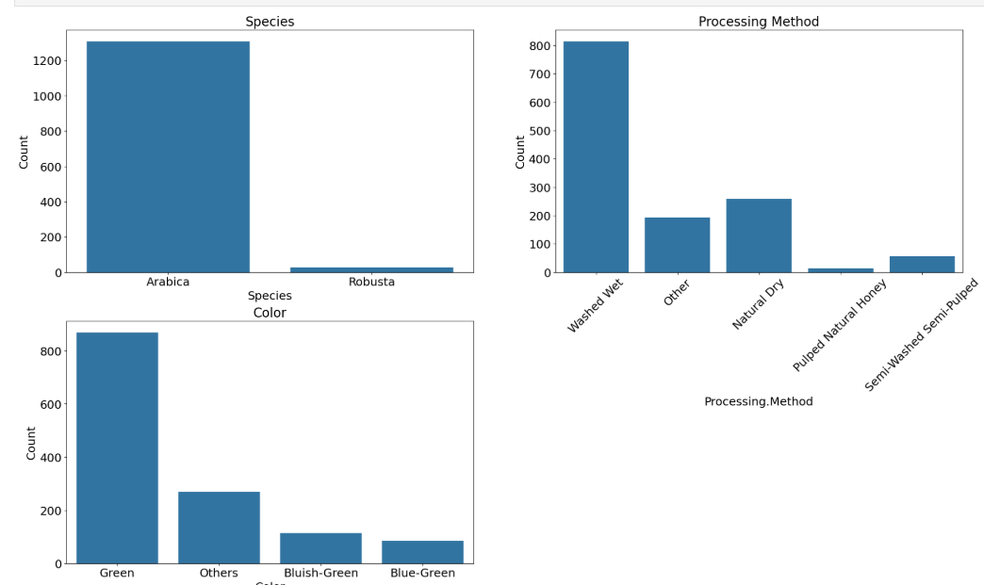
Univariate Analysis

Slide 7
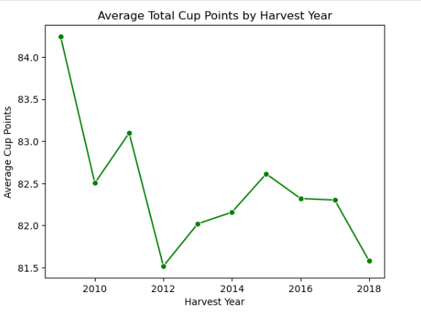
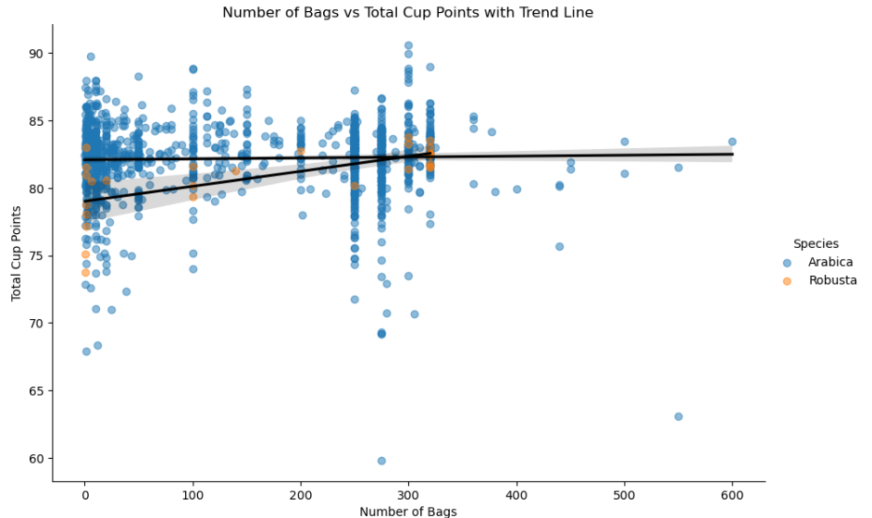
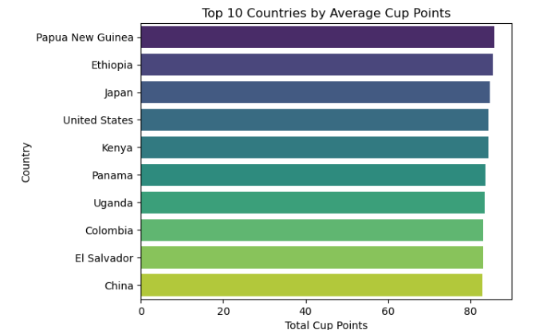
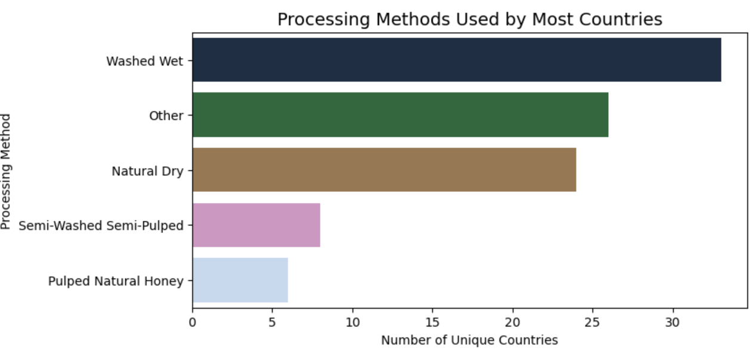
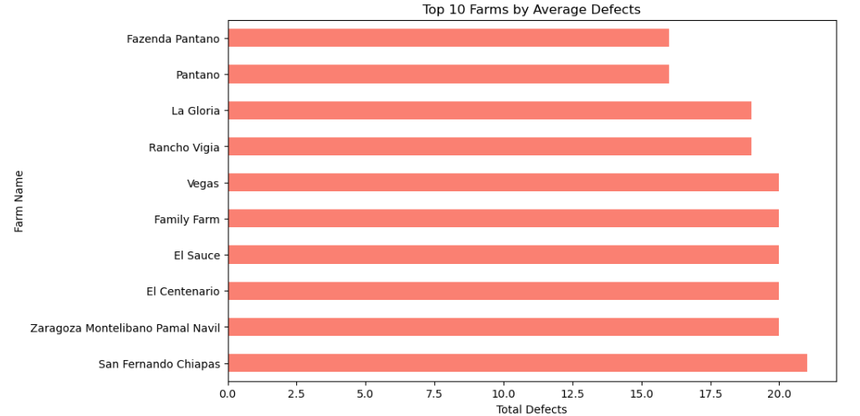
Bivariate Analysis

Slide 8
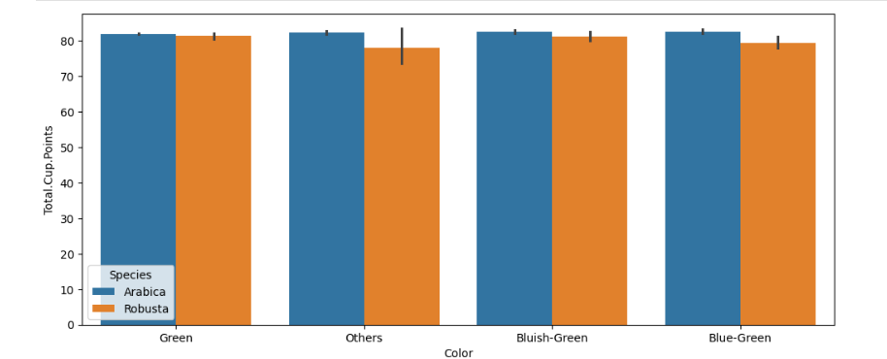
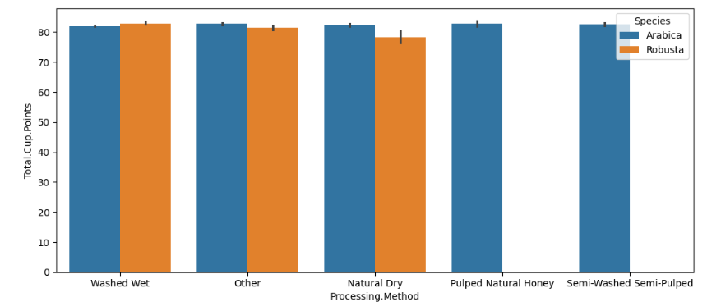
Multi-Variate Analysis

Slide 9
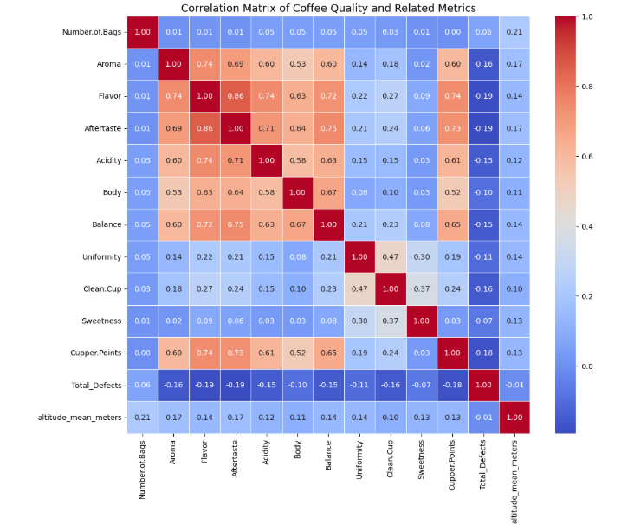

Slide 10
Hypothesis Testing
1. Independent T-Test
Purpose: Compare mean cup Points of Arabica vs Robusta coffee.
H₀: Mean cup points of Arabica and Robusta are equal.
H₁: Mean cup points of Arabica and Robusta are different.
To check if species type affects coffee quality.
2. One-Way ANOVA – Variety vs Total Defects
Purpose: Compare mean defects across coffee varieties.
H₀: All varieties have the same average defects.
H₁: No,variety has a different average defects.
To see if variety affects bean defect levels.
3. One-Way ANOVA – Country vs Cup Score
Purpose: Compare average cup points across countries of origin.
H₀: All countries have the same mean cup points.
H₁: No, country has a different mean cup points.
To analyze whether origin influences coffee quality.
.

Slide 11
Key Insights
Papua New Guinea, Ethiopia, and Japan lead in cup quality. Farms like Metad Plc and El Aguila consistently deliver exceptional results.
Arabica generally scores higher than Robusta, shows fewer defects, and dominates the sample population.
Coffee production peaked in the early 2010s, with noticeable declines in later years. A gradual drop in cup quality was also observed over time.
Washed/Wet is the most common and widely preferred processing method across countries. Bean color and processing methods show minimal impact on overall cup quality.
There is no strong link between altitude and cup quality. Interestingly, larger batches tend to have fewer defects. Some farms, like Fazenda Pantano, may need attention due to higher defect levels.
Grading delays are common. However, certifications from producers like Metad Agricultural and Ethiopia Commodity Exchange are often associated with higher cup quality.
Key attributes such as aroma, flavor, and acidity show strong positive correlations. Sweetness and uniformity remain consistently high, while higher defects tend to slightly reduce aftertaste quality.

Slide 12
Conclusion
Origin, species, processing method, and certain sensory attributes play a significant role in quality assessment.
While Arabica consistently performs better, external factors like altitude and processing do not guarantee quality.
Certifications and proper grading practices appear to support higher quality outcomes.
The analysis can guide producers, exporters, and buyers in understanding what contributes most to high-quality coffee.
Overall, data-driven insights can help improve coffee production standards and maintain consistency in quality.

Slide 13
THANK YOU

